Slide 1
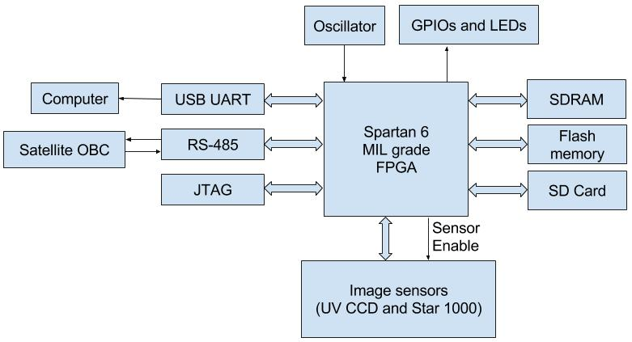
FPGA caching
FYP proposal

Slide 2
Sommaire
Motivation
Where it comes from
Why
Other applications
POC dev
Phases
Verilog
Testbench
TLA+
(optional) FPGA implementation
Support
MS
Existing research / implementations

Slide 3
Why
Why is it useful to add caches on FPGAs?

Slide 4


Electronic trading Data flow
TCP Ack
+ <3beats
UDP MD
Sim 1005
Xetra QA
Matches ask & bid
MARKET
Vmm 1006
FPGA
Risk check (volume, quantity)
TCP headers
Hearbeat
Fast cxl
Proxima
Builds order book
LDA 07
TCP Ack
+ Heartbeats
Quoterx
Logs
Past orders
UDP Market Data

Slide 5
Electronics trading
Data rd/write
UDP MD
TCP Ack
+ <3beats
Xetra QA
Quoterx
FPGA board
Rd
Basic logic:
Heartbeat
Risk check
Cancels
Dual port RAM
Validates
Rd/Wr
Cache (L1)
Client orders
VMW
Market
Quoterx
Ask/bid
Rd/Wr
Wr

Slide 6
Electronics trading
Data rd/write
UDP MD
TCP Ack
+ <3beats
Xetra QA
Quoterx
FPGA board
Dual port RAM
Requires arbitrator – 2 writes simultaneous
Over N clock cycles
Basic logic:
Heartbeat
Risk check
Cancels
Validates
Client orders
VMW
Market
Quoterx
Ask/bid
Cache Cache (L1)
1. 2x Rd and Writes
2. Up to date changes
3. MESI protocol

Slide 7
Why caching?
Real time orders from Clients, usually repeated (same client several orders)
Access memory for orders = 6 clock cycles
Less delay → act early on the market → bigger benefices
Consistency – keep in state modified for longer if client keep making same orders to ensure safety
Risk management

Slide 8
How is it special
Different from existing caching protocols on fpgas

Slide 9
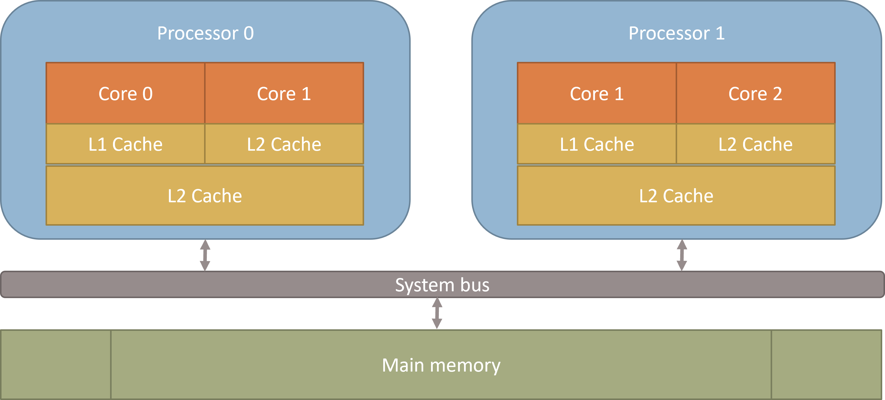
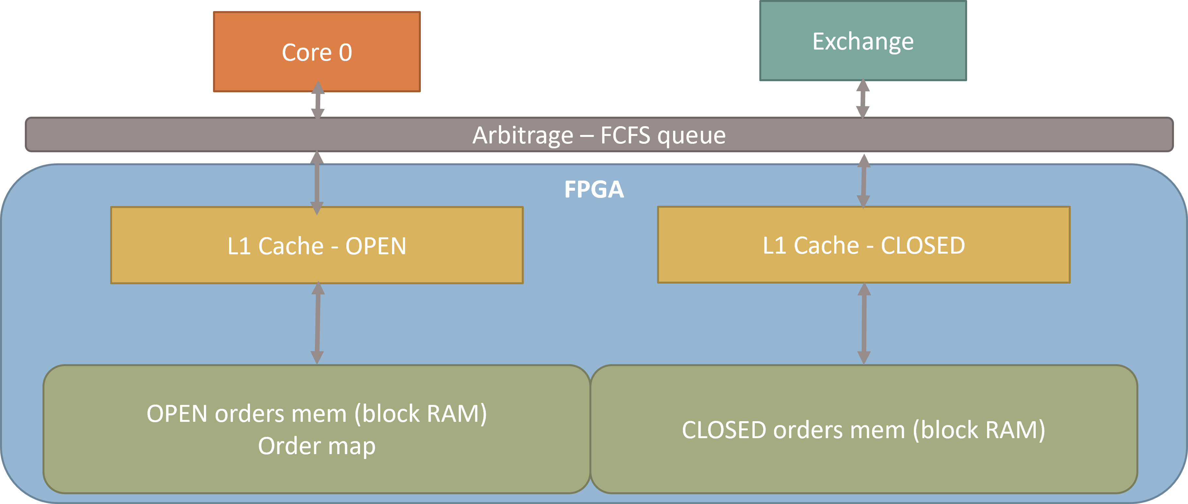
Conventional vs designed for trading model
Dual multicore processor
OPEN/CLOSEd order books

Slide 10
Caching – dual multicore processor
Processor 0
Processor 1
Core 0
Core 1
Core 1
Core 2
L1 Cache: 4-5 cycles
L2 Cache: 32KB
L1 Cache
L2 Cache
L2 Cache: 12 Cycles, 256KB
L2 Cache
System bus
Main memory 12 cycles + RAM Latency (e.g 30 cycles)

Slide 11
Current exchange model
Exchange
CPU
FPGA
Upstream message processor
Downstream message processor
RD/WR arbiter
RD/WR arbiter
Read Only
Accumulated risk and risk limit (block RAM)
Accumulated total reduced risk (block RAM)

Slide 12
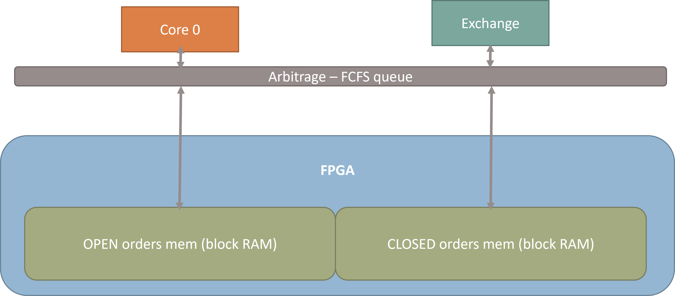
Existing model
Cached model
Order from A&Co, 50k
Order from A&Co, 50k
Incoming order sent to FPGA

Slide 13
Existing model
Cached model
Order from A&Co, 50k
Order from A&Co, 50k
A&Co line cache copy
A&Co line cache, limit = 100k
A&Co line cache, limit = 100k
Order sent to exchange by FPGA
Wrote in memory “OPEN”
Order sent to exchange by FPGA
Cache line loaded from OPEN memory
Write order to OPEN cache line

Slide 14
Existing model
Cached model
Cancel order from A&Co, 50k
Cancel from A&Co, 50k
A&Co line cache copy
A&Co line cache copy
A&Co line cache, limit = 100k
A&Co line cache, removed 50k
A&Co line cache, limit = 100k
Order cancel sent to exchange by FPGA
Wrote in memory “CLOSED”
Order cancel sent to exchange by FPGA
Cache line loaded from CLOSED memory
Write order to CLOSED cache line

Slide 15
Existing model
Cached model
A&Co line cache copy
A&Co line cache copy
A&Co line cache, limit = 100k
A&Co line cache, cancel = 50k
A&Co line cache, limit = 50k
A&Co line cache, cancel = 50k
IDLE
Both cache line copied to memory

Slide 16
Example time analysis – order and cancel
Read large block RAM = 6 cycles
hit = 6 cycles wait
Read cache = 1 cycle
Processing = 6 cycles
GETUDP
MD
Check & process & packet for order
Read ORDER RAM
Cache hit return order
Using cache
Cache read
Send Cxl
Send UDP MD
GETUDP
Cxl
Check & process & packet for order
Cache read
Read CXL RAM
Cache hit return CXL
GETUDP MD
Check & process & packet for order
Read ORDER RAM
waits
Send Cxl
Memory only
Send UDP MD
GETUDP
Cxl
Cache hit return order
Check & process & packet for order
Read CXL RAM
Cache hit return CXL
hit
miss
Check & process & packet for order
Read CXL RAM
Cache hit return CXL
Send Cxl
0 2 4 6 8 10 12 14 16 18 20 22 24 26 28 30 32 34

Slide 17
Example time analysis – order and cancel
GETUDP
MD
Read order from cache
Write Order cache
Writes to ORDER RAM
Using cache
Send UDP MD
GETUDP
Cxl
Read order from cache
Send Cxl
Writes to Cxl RAM
Write Cxl cache
4
Check & process & packet for order
Send UDP MD
4
GETUDP MD
Memory only
GETUDP Cxl
Check & process & packet for order
Send Cxl
Writes to Cxl RAM
Writes to ORDER RAM
5
10
15
20
25
30
35
40
45
50
55
60
65

Slide 18
TODO
- cpu initialize order limit in the morning
Table for symbol with example – accumulated risk and risk budget (A), reduced risk (B)
Step by step from
1. initialize sunny day scenario
2. Order 1
3. Order max – canceled
4. Cancel order
5. new order
6. CPU changes risk budget same time accumulated risk
7. Cancel same time as order – independent update of A and B

Slide 19
2 port model – 2 port read and 2 ports write – when using testbench compile with Questa – support 2 port dual memory

Slide 20
Ask about latency for memory v=and if caching could increase business opportunity
Explain Real case
Tokyo Stack Exchange TSE reduce latency
TLA+

Slide 21
How - MESI
How to approach the task

Slide 22
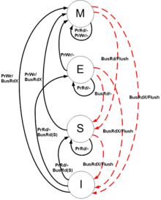
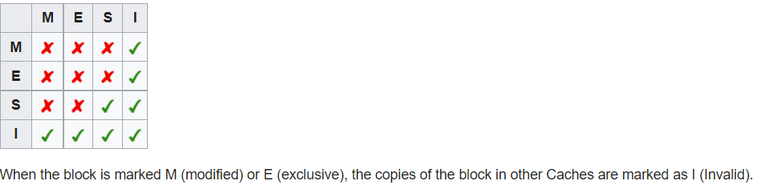
Snooping protocol for caches

Slide 23
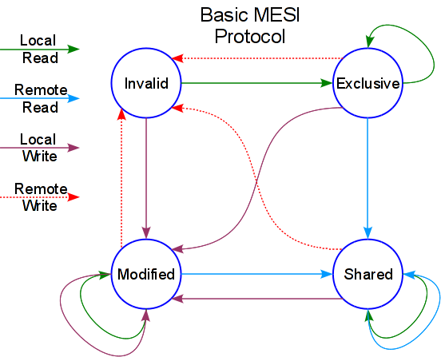
Each cache – managed with MESI

Slide 24
Implementation - POC
How to approach the task

Slide 25
Success points
MESI protocol research
Verilog implementation
Testbench
Verification
TLA+ implementation
Running TLA+ - all possible cases on simulated board
Diagrams, conclusions, approach & writing FYP

